Slide 1

Implementation of EAAL in Slovenia – fresh impetus to awareness raising
by Zvonka Pangerc Pahernik,
EAAL national coordinator

Slide 2

Slovenia and adult education
Area: 20,273 km2
Population: 2,056,262
Adults (15+): 1,761,726
Labour force: approx. 1 mio
Registered unemployment: 13 %
Youth unemployment: 16,9 %
Participation in LL: 16.2 % in 2010, 12,6 % in 2013
Problems in the background!
No PIAAC results for now

Slide 3
Legal basis for adult education (AE) and lifelong learning (LL)
Act on Financing and Organisation of Education (1996)
Adult Education Act (1996; status of AE)
Adult Education Master Plan (2005–2010, 2013–2020):
  General, non-formal adult education and learning
  Formal adult education
  Job-related adult education and training
  Supporting activities (guidance, promotion, quality…)
Financing until 2020: approx 400 mio EUR
Annual AE Programme (goals, activities and funds)
Lifelong Learning Strategy (2007)

Slide 4
Slovenian Institute for Adult Education (SIAE)
Founded in 1992
Umbrella institute for development of AE
Financed by
  Ministry of education, science and sport
  Ministry of labour, family and social affairs
  European Structural Funds and other EU funds
Four clusters:
  Research and development
  Guidance and validation
  Quality and training of adult educators
  Promotion and information
National coordinator of the implementation of EAAL

Slide 5
Implementation of EAAL – aims:
Popularisation of EAAL's key messages
Awareness raising on AE and LL
Promoting and upgrading existing national endeavours
Activate coordinators and networks at local level
Strengthen cooperation among stakeholders
Present examples of good AE practice
Attract the widest public, especially the low skilled
Explore the concept of learning communities

Slide 6
Implementation of EAAL - activities
Learning Parade (LP) – festivals in seven public places per year + one professional event per LP
  Presentations of LL providers on stands
  Appearances on stage
  Workshops
  Video-presentations
Video-publications on examples of AE practice
Definition of learning community
E-corner
Other awareness raising

Slide 7
Lifelong Learning Week in Slovenia
19 years of implementation (http://llw.acs.si)
Country-wide abundance of events:
  In 1996: 70 providers, 500 events
  In 2014: 1,500 providers, 11,800 events
Awards for the promotion of learning: http://llw.acs.si/awards/winners
National LLW opening: http://llw.acs.si/opening
Adult Education Colloquium: http://llw.acs.si/ac
Role models attract campaign: http://llw.acs.si/learners

Slide 8
Learning Parade (LP) 2013 and 2014
Website: http://llw.acs.si/learningparade
Condensed celebrations of LL in public places
Joint endeavour of LP coordinator and network of partners
Contents related to local circumstances
All generations, all walks of life
Strong support by local municipalities as well as national policy-makers
Learners‘ engagement

Slide 9
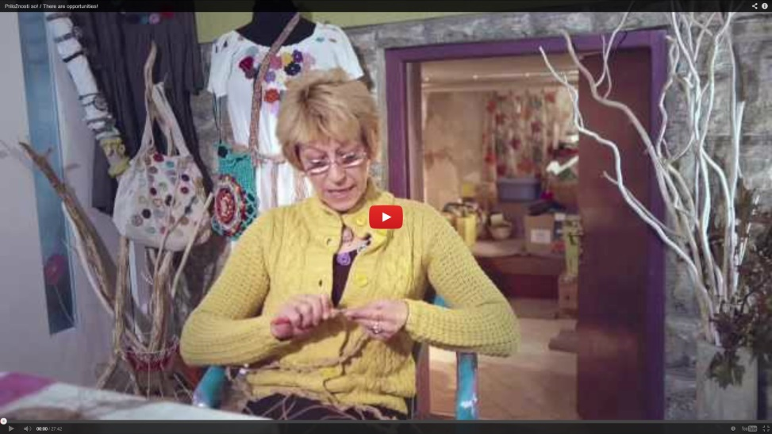
Video on educational programmes for the unemployed
There are opportunities! Training programmes for the unemployed
http://llw.acs.si/learningparade/video1
Video on assuring high-quality services by education providers as well as other mechanisms which enable participants, in this case the unemployed, to develop new skills and competences, necessary for adaptation to the ever-changing environment. Examples of cooperation and partnerships among several stakeholders at the local level are shown and the transferability of the basic educational programme to other topical and geographical areas is set out.

Slide 10
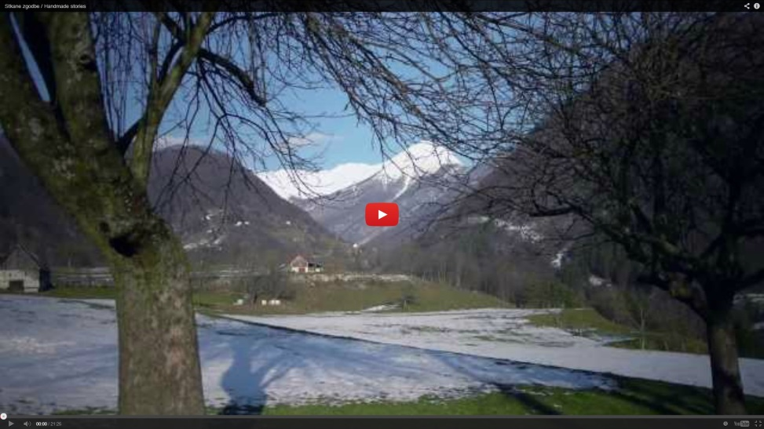
Video on literacy programmes in the rural area
Handmade stories! Rural areas as an opportunity for the development of basic skills and key competences
http://llw.acs.si/learningparade/video2
The video‘s focus is on providing opportunities for adults to develop all forms of basic skills and key competences, intensifying intergenerational cooperation and partnerships at local level, in this particular case in a rural area, as well as on assuring quality of adult educators' and provider institutions' services. In addition, the transferability of the educational programme's model for the development of adult literacy, and experiences gained through its implementation to other topical and geographical areas is set out.

Slide 11
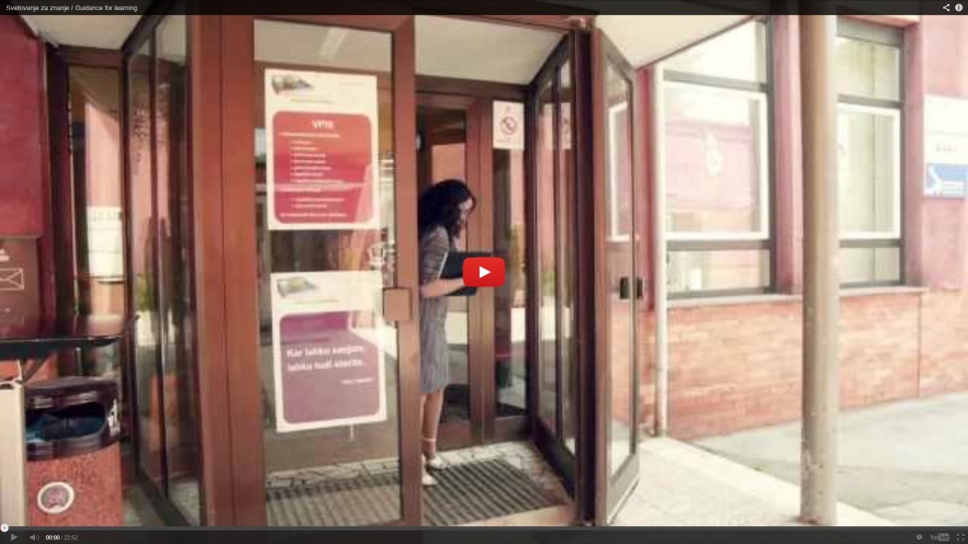
Video on guidance and validation of prior learning
Guidance for learning. Educational guidance support for adults http://llw.acs.si/learningparade/video3
The video‘s focus is on providing comprehensive and easily accessible information and guidance systems as well as systems for validating non-formal and informal learning. The professional point of view, presented by Slovenian experts in this field, is reinforced by learners'/clients' testimonies.

Slide 12
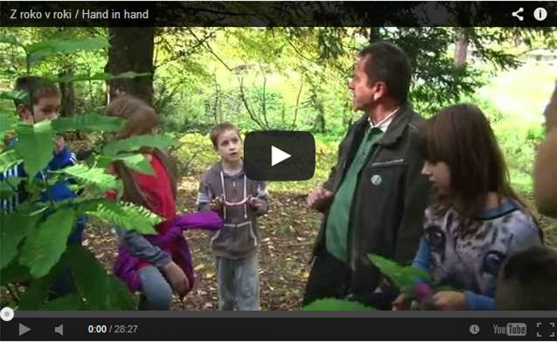
Video on learning communities
Hand in hand - Learning in a community for personal and common good
http://llw.acs.si/learningparade/video4
The video‘s focus is on presenting the value of community learning. Mutual learning and interaction between individuals and communities they live and work in establishes long-lasting ties, even a common identity. In the video, examples of good practice illustrate the social inclusion of young people, the integration of immigrants with support of the local community, and networking in rural areas where stories of sustainable development are shaped and experienced jointly by different stakeholders (citizens, municipalities, entrepreneurship centres, public institutes, societies etc.).

Slide 13
Other activities:
Definition of a learning community –draft and testing (http://llw.acs.si/learningparade/communities)
E-corner – collection of information on e-education and learning (http://llw.acs.si/learningparade/ecorner)
Milestone events
  Annual Adult Education Conference 2013
  Adult Education Colloquium 2014
Dissemination activities
  E-bulletin (http://tvu.acs.si/datoteke/paradaucenja/PU_2013_E-bilten_ENG.pdf)
  Video-links distributed to stakeholders
  Articles, promotional materials
  Presentations at events at home and abroad
  Social media (FB) etc.

Slide 14
Findings:
Strengthened ties among partners at local level
Newly established or reinforced partnerships
Many new people have been attracted to learning
Existing learners had their share in shaping events
Municipalities have gained new interest in AE
Professional work has been strengthened by video-promotion, there are new developments
Learning communities have been identified as a new culture of living

Slide 15

Plans for 2014/2015
Third series of LP in 7 new venues
  To support the 20th LLW
  To cover the whole country with LPs (21)
  To adopt the LP approach in the future
Promoting Adult Skills (PAS) events
  To upgrade cooperation with LP coordinators
  To identify existing literacy programmes
  To come up with recommendations

