Slide 1
Adult Educational Guidance Counselling Ireland - an Overview
Jennifer McKenzie
Director
NCGE, Ireland
XIX Adult Education Forum
„Adult on a Learning Journey“
Tallinn, Estonia
Friday 16th October 2015

Slide 2
NCGE - agency of the Department of Education and Skills.
Mission : To Develop, support and influence quality guidance provision in the education and training sector as part of lifelong learning in accordance with national and international best practice
Provide CPD for guidance counsellors
Provides resources
Chair relevant national committees on guidance
European remit – Euroguidance / Academia etc.
Work with National Stakeholders – e.g. Dept. Social Protection, SOLAS ( FET Authority) etc.
Ireland – major changes in Education and Training Sector since 2014

Slide 3
Today…
What do we mean by Adult Guidance in the context of lifelong learning?
What are we currently doing in Ireland?
What are the next steps ?
Q&A

Slide 4
Guidance – definitions
EU Council Resolution on Guidance, 2004
In the context of lifelong learning, guidance refers to a range of activities that enables citizens of any age and at any point in their lives to identify their capacities, competences and interests, to make educational, training and occupational decisions and to manage their individual life paths in learning, work and other settings in which these capacities and competences are learned and/or used.

Slide 5
Guidance – definitions
Ireland - National Guidance Forum Report 2007
Guidance facilitates people throughout their lives to manage their own educational, training, occupational, personal, social and life choices so that they reach their full potential and contribute to the development of a better society.

Slide 6
Guidance provision in Education Sector
Post Primary schools ( aged 12 – 18) : Guidance Counsellor – school teacher
Further Education Colleges ( age 18 +) Guidance Counsellor – school teacher
Higher Education Careers Services ( i.e. universities)
Adult Education Guidance (over 16 yrs. with no formal education qualifications) – community and adult education & training centres

Slide 7
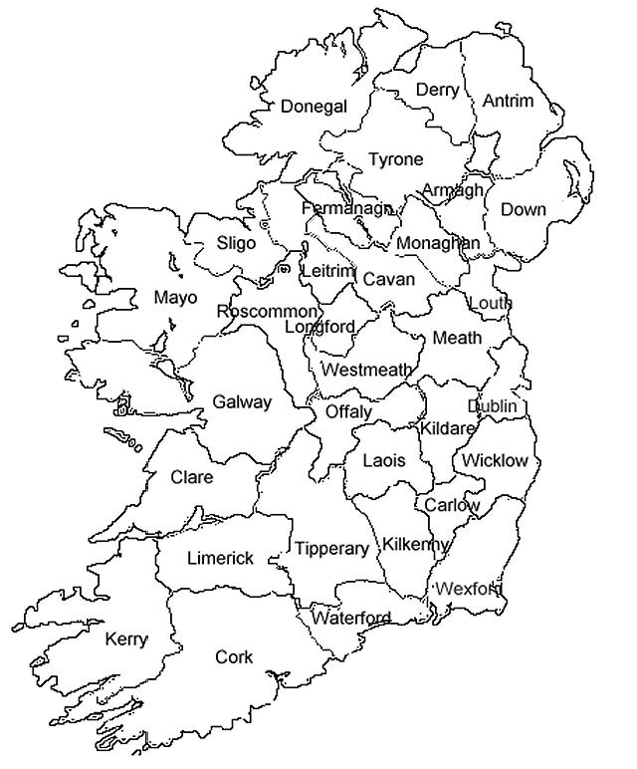
Adult Educational Guidance Initiative
40 AEGS nationwide
Located within 16 ETBs and WIT
Adult Educational Guidance
Co-ordinator
Adult Educational Guidance Counsellor
Adult Guidance Information Officer

Slide 8
Guidance Quality Framework (NGF 2007)
Informing
Advising
Counselling
Assessing Teaching & learning
Enabling
Advocating
Networking
Providing feedback
Managing
Mentoring
Innovating systems change

Slide 9
Codes of Principles (NGF 2007)
Accessible
Appropriate
Confidential
Equality of Opportunity
Impartial
Individual Ownership & responsibility
Integrated
Quality Standards of delivery
Team approach
Transparent
Complaints handling

Slide 10
AEGI Staff Qualifications
Adult Education Guidance Co-ordinator/ Counsellor
Post graduate qualification in Guidance
NFQ8, NFQ 9
Adult Guidance Information officer
Adult Guidance Theory & Practice Cert
NFQ 6

Slide 11
Model of Guidance Provision in AEGI
based in ETBs/ WIT
Specific Target groups
Integrated model of adult educational guidance counselling
pre-entry, entry, ongoing and pre-exit stages
personal, educational and vocational guidance
working in partnership at local level, meeting a spectrum of guidance needs of the target groups, employing a range of methodologies including information provision, one-to- one guidance, group guidance and outreach provision

Slide 12
AEGI - Guidance and Information available
Guidance
1-1
Group
Seminar
Adult Learner exhibitions
Information
Educational, local and national
Resources
ICT links, Factsheets, directories etc.
Welfare
Funding, Entitlements, grants
Notes:
Fact sheets / visuals -can provide initial info but the guidance will then qualify that info for the individual’s circumstances.
Eg group of ITABE people all working towards level 2……For progression possibilities – maybe into BTEI – the whole group will not have the same entitlements to access BTEI!
Eg VTOS applications – have to be 6 months unemployed etc – can deal with DSFA to look at individuals situation if they are 5 months / 3 weeks unemployed
Cant always generalise the information – still needs to be interpreted for each person.
Developing a relationship with the AEGS -
– factsheets can be developed for your service

Slide 13
Education / career planning
Careers/ vocational education
Learner
Social Development
Personal Development

Slide 14
What is adult guidance counselling?
Adult Guidance Counselling
Vocational
Psychological
Social
Personal
Educational
Information

Slide 15
Guidance process with an adult
Personal Issues
Educational Experiences / Hopes
Vocational Experiences / Hopes
Decision
Making
Plans /
Referrals/ feedback
Review / Follow-up
Information

Slide 16
Adult Education - Barriers to progression
Previous education experience
Literacy / numeracy Skills
Lack of ICT skills
Family commitments
Childcare
Travel
Language
Citizen Status – refugee / asylum seeker

Slide 17
Guidelines and Co-ordination
Guidelines for Guidance in Intensive Tuition of Adult Basic Education (ITABE)
Literacy Awareness Training for guidance staff /Guidance Awareness Training for literacy and Adult education staff
AEGI Operational Guidelines (2012)
Guidelines for the Integration of Contracted Guidance Staff Within the AEGI
NCGE – AEGI Guidelines on the Provision of Adult Educational Guidance Services to clients aged 16 and 17 years old

Slide 18
Co-ordination / Integration with Adult education…
Planning
In consultation with the courser co-ordinator / Core tutor
Relevant Agreed Information Exchange
Clarification of roles / confidentiality etc.
Recognising the individual needs within the group
Relevant and appropriate to group level
Feedback to the course co-ordinator / Core tutor
Notes:
the level the group is at
What modules / projects they are currently doing?
What information is relevant ?

Slide 19
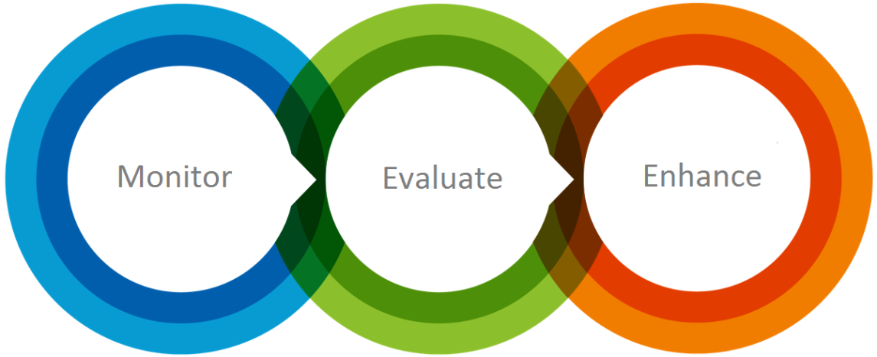
Quality Assurance
Monitoring and Evaluation
Qualitative & Quantitative reports
Case Studies
Guidance Counselling supervision
Guidelines
Provision of Continuous Professional Development

Slide 20
Statistics – AEGI
Database – Adult Guidance Management System
Client Information Management and Service reporting
Quantitative reports - Statistics
Qualitative reports
Service provision
Client issues
CPD required for staff
Case Study examples for sharing of practice

Slide 21
Statistics from NCGE AGMS 2014
No. of clients met 1-1 = 17369
No. of people in groups = 27454
No of people met for 1-1 after group = 3357
No. of general public queries 13998
Total 55464

Slide 22
NCGE – support for AEGI
Advisory group with DES
Qualitative and Quantitative reports
Continuous Professional Development
Adult Guidance Management System – national database – qualitative and quantitative data
Working groups for guidance development
Online Handbook with resources
Guidelines for practice

Slide 23
for AEGI
SOLAS and DES FET Strategy – Draft Guidance Framework
FET Guidance Service – to include AEGI, PLC and others
Develop formal FET Guidance Quality assurance system
Further develop Models of Guidance to meet needs of learners
Formal referral systems with Dept. Social Protection
Notes:
Generation Emigration

Slide 24
To support this work,
NCGE supports, co-operates with, informs and advises other government departments and national agencies on guidance issues to support AEGI – Future FET Guidance Service developments

Slide 25
Relevant Links
www.ncge.ie
http://www.ncge.ie/further-education/
http://www.ncge.ie/uploads/AEGI_Operational_Guidelines_2012__FINAL.pdf
http://www.education.ie/en/Publications/Policy-Reports/Further-Education-and-Training-Strategy-2014-2019.pdf pg 112-114 Section 10
http://www.ncge.ie/uploads/Guidelines_re_integrating_contracted_guidance_staff_201114.pdf
http://www.ncge.ie/uploads/NCGE__Guidelines_Provision_of_AEGS_to_16_and_17_Year_Olds__March_2014.pdf
www.solas.ie
http://www.ncgeadultguidance.ie/

Slide 26
Go raibh maith agaibh!
Thank you!
Aitäh
Jennifer.mckenzie@ncge.ie

